Slide 1


Azure Resources

Slide 2



Configure Azure Resources with the Azure Portal, PowerShell, and the CLI

Slide 3
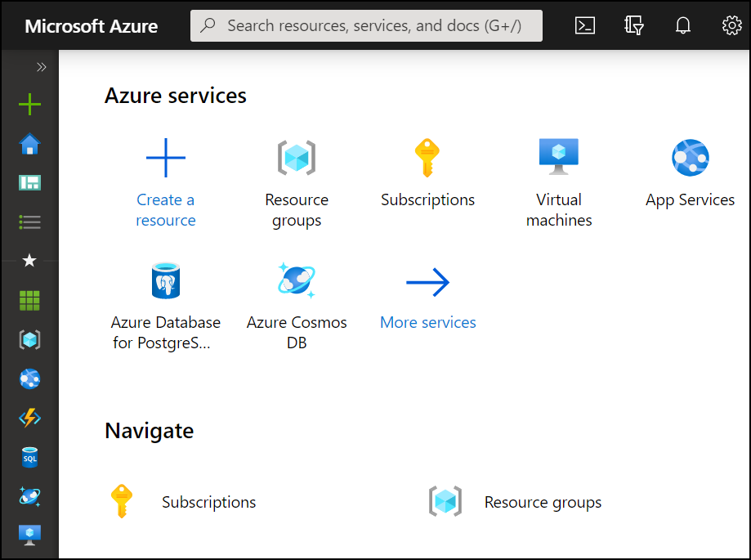
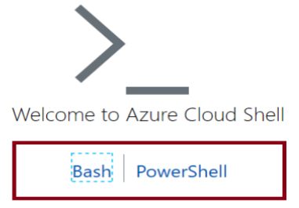
Compare Administrator tools
Azure Portal
View and manage resources Visual interface Unified hub – training and documentation Personalize your experience Mobile app Access the Cloud Shell One-off creation scenarios
Azure Cloud Shell
Interactive and browser-accessible with file storage Offers Bash or PowerShell Authenticates automatically Provided on a per-session and per-user basis Temporary - times out after 20 minutes
Azure PowerShell and CLI
Command line programs Interactive and scripting modes Cross-platform compatibility Good for repeatable deployments Familiar coding experience
az vm restart -g MyResourceGroup -n MyVm

Slide 4
Demonstration – Azure Portal
Customize your dashboard
Search for and locate resources
Support and help tickets

Slide 5
Demonstration – Cloud Shell
Access the Cloud Shell
Configure storage for the Cloud Shell
Explore PowerShell or Bash
Upload or download files to the storage
Use the Cloud Editor (optional)

Slide 6
Configure Resources with ARM Templates

Slide 7
Learning Objectives – Azure RM Templates
Explore the JSON Template Schema
Explore the JSON Template Parameters
Consider Azure Bicep Files
Demonstration – QuickStart Templates
Learning Recap
Manage Azure identities and governance (20–25%): Automate deployment of resources by using templates
Modify an ARM template
Deploy a template
Save a deployment as an ARM template

Slide 8
Review ARM Template Advantages
Ensures consistent deployments and supports reuse
ARM
Template
Reduce manual, error prone, and repetitive tasks
Express complex deployments
Development
Express requirements through code
Production
Provides validation tasks
Modular designs with the ability to link templates.
Quality
Assurance
Simplifies orchestration

Slide 9
Explore the JSON Template Schema
{
"$schema": "http://schema.management.
azure.com/schemas/2019-04- 01/deploymentTemplate.json#",
"contentVersion": "",
"parameters": {},
"variables": {},
"functions": [],
"resources": [],
"outputs": {}
}
Defines all the Resource manager resources in a deployment
Written in JSON
A collection of key-value pairs
Each key is a string
Each value can be a string, number, Boolean expression, list of values, object

Slide 10
Explore the JSON Template Parameters
"parameters": {
"adminUsername": {
"type": "string",
"metadata": {
"description": "Username for the VM."
}
},
"adminPassword": {
"type": "securestring",
"metadata": {
"description": "Password for the VM."
}
}
}
Specifies which values are configurable when the template runs
This example has two parameters: one for a VM’s username (adminUsername), and one for its password (adminPassword)

Slide 11

Consider Azure Bicep Files
Simpler syntax for writing templates
Bicep file
resource storageAccount 'Microsoft.Storage/storageAccounts@2021-01-01' = {
name: storageAccountName
location: location
tags: {
displayName: storageAccountName
}
kind: 'StorageV2'
sku: {
name: 'Standard_LRS'
} }
Smaller module files you can reference from a main template
Automatically detect dependencies between your resources
Visual Studio Code extension with validation and IntelliSense

Slide 12
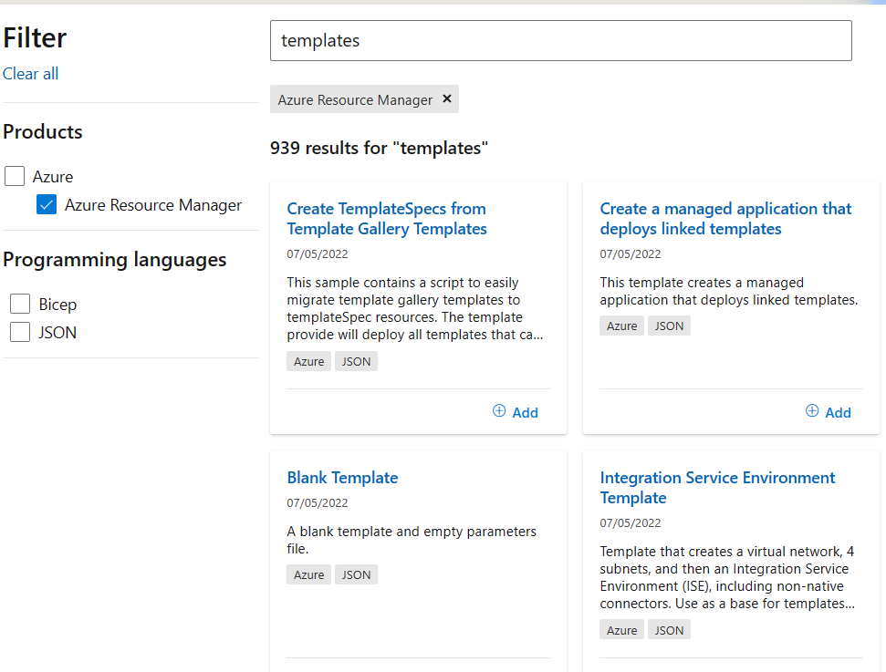
Demonstration - Quickstart templates
Locate the Azure Quickstart template gallery
Deploy a JSON or Bicep template

Slide 13
Lab - Manage Azure resources by Using ARM Templates

Slide 14
Lab 03 – Manage Azure resources
With templates
Job Skills
Task 1: Create an Azure Resource Manager template.
Task 2: Edit an Azure Resource Manager template and redeploy the template.
Task 3: Configure the Cloud Shell and deploy a template with Azure PowerShell.
Task 4: Deploy a template with the CLI.
Task 5: Deploy a managed disk using Azure Bicep. the CLI
the CLI
In this lab, you learn how to define your resource infrastructure using Azure Resource Manager templates.
Templates ensure consistency and let you create multiple resources at one time.
You learn to deploy templates with the Azure portal, Azure PowerShell, or the CLI.
Notes:
This lab introduces the student to resource manager templates, Cloud Shell, Azure PowerShell, Bash (CLI), and Bicep. As of the 23 Feb 2024 course update there is only one lab.
Lab 03b - https://microsoftlearning.github.io/AZ-104-MicrosoftAzureAdministrator/Instructions/Labs/LAB_03b-Manage_Azure_Resources_by_Using_ARM_Templates.html

Slide 15







Lab 03 – Architecture diagram
az104-rg3
Edit
Task 2
(Portal)
Disk 2
Task 1
Task 3
(PowerShell)
Export
Disk 3
Disk 1
Task 4
(CLI)
Template
Disk 4
Task 5
(Bicep)
Disk 5

Slide 16
Thank You!

